Slide 1


SURAKSHA CYBER HACKATHON-2026
CANARA BANK
Title:- Reg Twin AI
Theme- Agentic Regulatory Intelligence & Compliance

Slide 2
Our Solution
Reg Twin AI automates this process by using Artificial Intelligence to:
Analyse regulatory documents
Generate concise summaries
Create Measurable Action Points (MAPs)
Assign responsibilities to the relevant departments
Provide a centralized compliance dashboard
Problem Statement
Banks receive hundreds of RBI/SEBI/FEMA circulars every year. Compliance teams spend hours manually reading documents, identifying action points, and assigning them to departments.
Technologies Used
Frontend: React.js, Material UI
Backend: Fast API (Python)
Database: PostgreSQL with SQL Alchemy
AI Engine: LLM for document understanding
PDF Processing: PyMu PDF

Slide 3
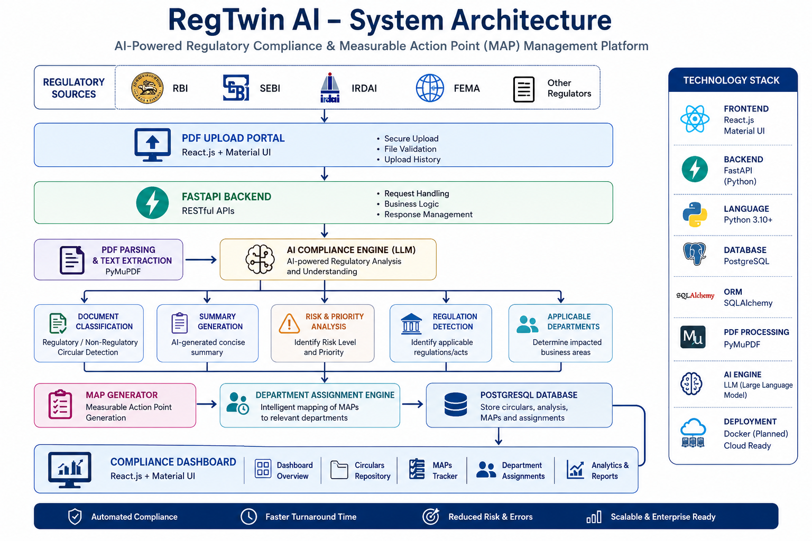

Slide 4
Real-World Banking Use Case
Existing Process
Compliance officers manually review lengthy regulatory documents.
Action points are extracted manually.
Departments are informed through emails and spreadsheets.
Tracking compliance status is difficult and time-consuming.
Using Reg Twin AI
Upload the regulatory PDF.
AI analyses the content instantly.
Generates summaries and MAPs automatically.
Assigns the appropriate department.
Displays the compliance status on a centralized dashboard.
Benefits
Faster regulatory processing
Reduced manual effort
Improved compliance accuracy
Better visibility and accountability

Slide 5
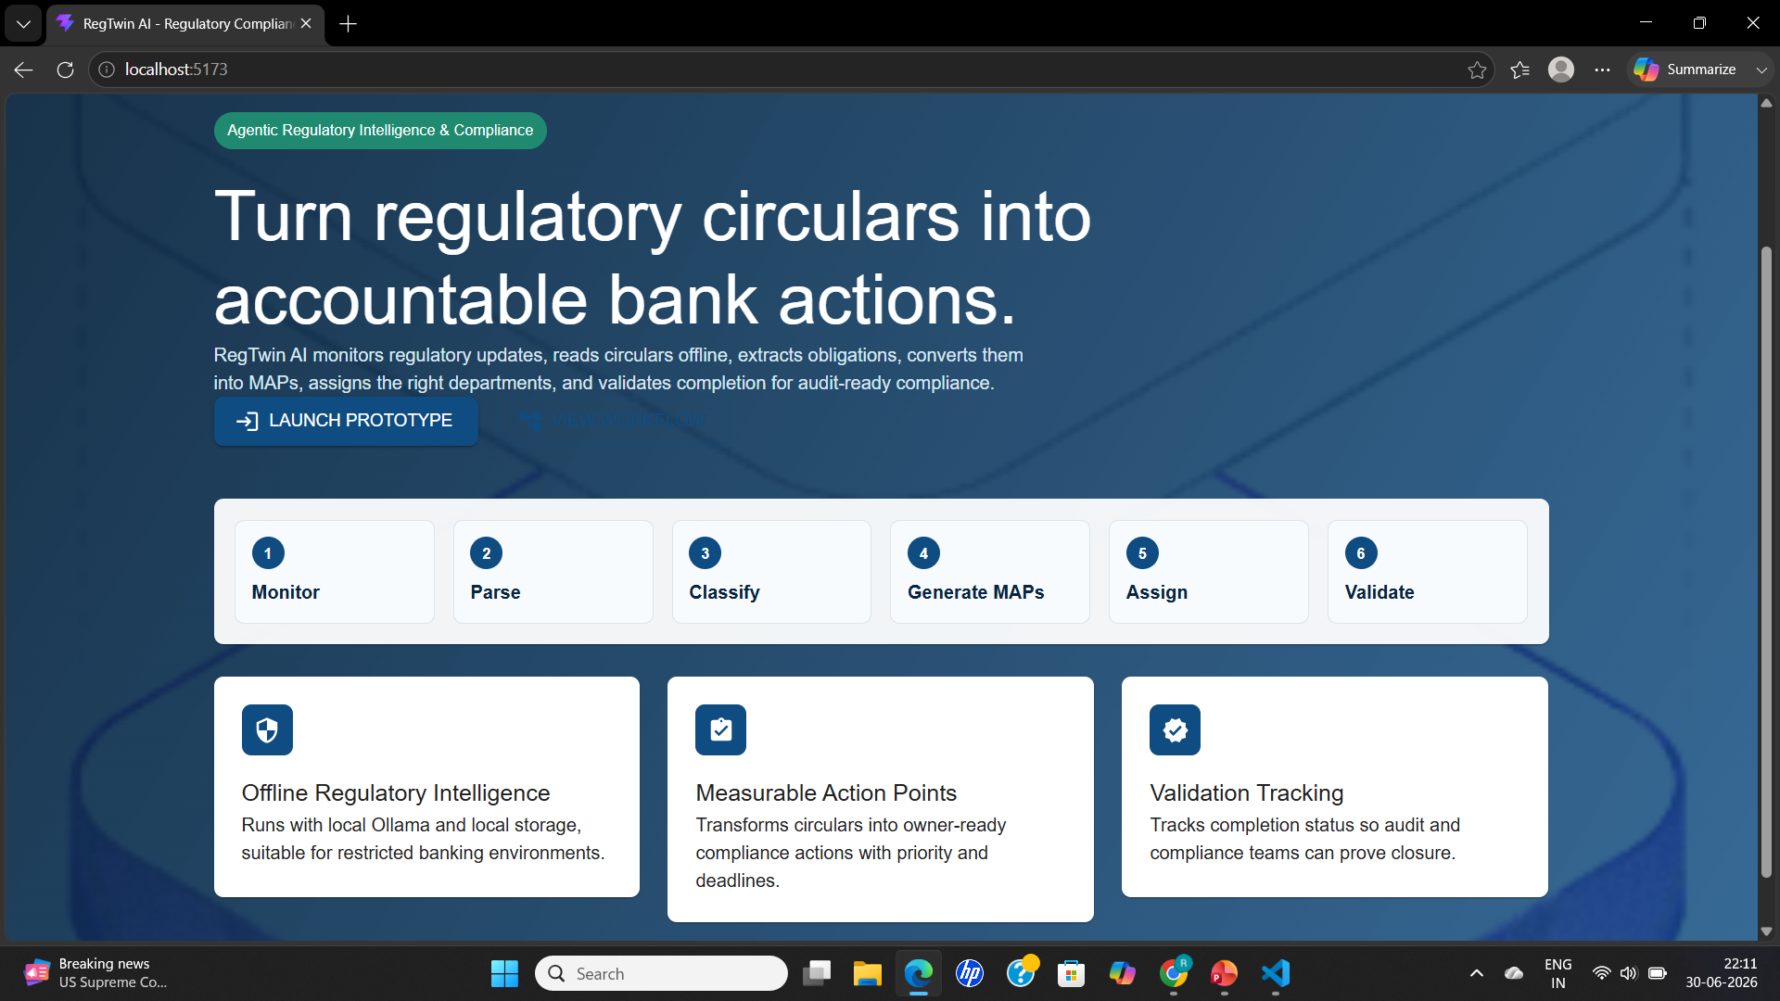
Unique Selling Proposition (USP)
What Makes Reg Twin AI Different?
AI-Driven Compliance Intelligence
Understands the context of regulatory documents instead of simply extracting text.
Measurable Action Point (MAP) Engine
Converts regulations into clear, actionable compliance tasks that teams can execute.
Intelligent Department Assignment
Uses banking-specific keywords to recommend the most appropriate department for each action point.
Centralized Compliance Dashboard
Provides real-time visibility into:
Processed circulars
Risk and priority levels
Pending action points
Department assignments

Slide 6
Impact, Scalability & Future Scope
Business Impact
Reduces manual compliance effort by over 90%
Accelerates regulatory response time
Minimizes operational and compliance risk
Improves accountability through MAP tracking
Enhances decision-making with AI-driven insights
Future Enhancements
Integration with Core Banking Systems
Email and Microsoft Teams notifications
Multilingual regulatory document support
Approval workflows for compliance teams
Cloud deployment for enterprise scalability
Why Reg Twin AI?
Reg Twin AI goes beyond document analysis. It transforms complex regulatory circulars into actionable business tasks, assigns ownership, and helps banks respond to regulatory changes faster, smarter, and more efficiently.

Slide 7
Thank You!
By:-
Cyber Sentinels

